Slide 1
Welcome to 4th period Leadership Elective
Ms. Cornick
6th Language Arts Literacy Teacher/ Leadership Teacher
“Always do what is right. This will surprise some people and astonish the rest.” Mark Twain
Notes:
Introduce students to the course.

Slide 2
Course Outline
In this elective, we will focus on self-awareness, the qualities of leadership, and how we can become leaders for ourselves and others.
Part One: Finding the Leader within Me
Part Two: Being an Advocate for Others
Notes:
Explain expectations of the students in this course:
becoming self-aware of actions, behaviors in order to become leaders
leaders aid others whenever possible, however, leadership starts within us

Slide 3
Who am I???
Read the Who am I? riddle that you were given and in your notebook try to solve it.
Hint: It is a pattern of behavior!
Notes:
Distribute riddle handout to class. Read the riddle aloud while they read silently. Give the students 7-10 minutes to solve the riddle.

Slide 4
The Answer is …
I am Habit.
Notes:
Ask students to share their answers. If no one volunteers to share their answer or gives the correct answer, the teacher will break up each section of the riddle and attempt to solve it as a whole group. Teacher will solicit answers from the students and proceed to reveal the answer to the riddle.

Slide 5
Our Book
We will be reading Sean Covey’s 7 Habits of Highly Effective Teens in our classroom Kindle.
Students will receive a used paperback copy of the book to keep at home for future homework assignments.
Notes:
Introduce the book and explain that it will help us on our journey of discovering who we are and how we interact with others.

Slide 6
A video from the Author
Sean Covey recorded a video explaining his rationale for writing this book.
http://www.seancovey.com/books_7habits_introvid.html
Notes:
Show clip
Pass out Kindles, paperback versions of 7 Habits, and 7 Habits workbook.
Read pages 3-10 of 7 Habits

Slide 7
Get in the Habit
Habit 1: Be Proactive
Habit 2: Begin with the End in Mind
Habit 3: Put First Things First
Habit 4: Think Win-Win
Habit 5: Seek First to Understand, Then to be Understand
Habit 6: Synergize
Habit 7: Sharpen the Saw
Notes:
Be proactive (take action and be responsible)
Begin with an end in mind (consciously plan out and visualize your actions)
First things first (set priorities and carry them out)
Think win-win (in negotiation, seek solutions that help both yourself and the other person)
Seek first to understand, then be understood (in communication, listen actively before you talk)
Synergize (in work, open yourself to others to work effectively in teams)
Sharpen the Saw (relax, rejuvenate, and revitalize yourself)
Taken from Wikibooks
Read pages 3-10 of 7 Habits

Slide 8
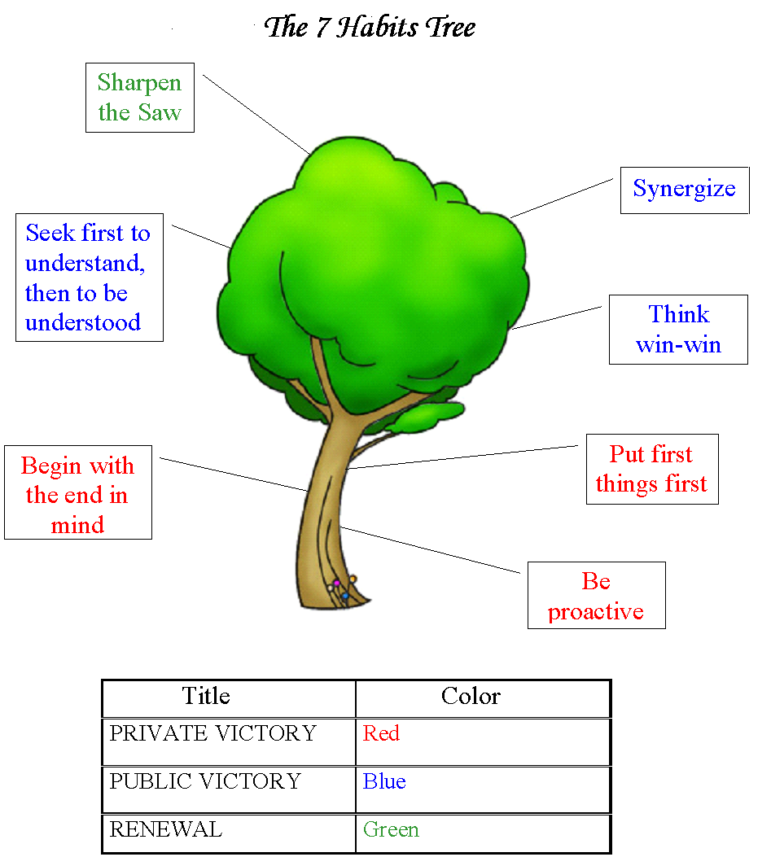
The 7 Habits Tree
The 7 Habits build on each other.
List all the “good” habits you have acquired, and briefly discuss these with a partner.
Now, identify some of the bad habits you are practicing.
Notes:
Have students list good habits they have and have them do a “think, write, pair, share” about them. Next, have students identify their bad habits. Teacher will ask for volunteers to share their response.

Slide 9
Paradigms and Principles
A paradigm is a perception a person has about things.
What are some paradigms you have about yourself? I.e., How do you perceive yourself? Smart? Artistic?
What are your paradigms about others around you?
A principle is a natural law or basic truth (i.e., love, honesty).
What principles are important to you? Why?
What principle do you center your life around? Why?
List principles you find most difficult to live.
Notes:
Read pgs 11-28
Answer questions above in notebook or engage in a class discussion.

Slide 10
Overall
Habits are learned behaviors.
Habits can be changed
Paradigms are just your perceptions.
Principles are the things we value.
Notes:
Recap of today’s lesson.
Briefly discuss next lesson which is Habit 1: Be Proactive.

